Slide 1


State Department for the Development of Arid and Semi-Arid Lands
Principal Secretary – Micah Powon
ONE - HEALTH

Slide 2
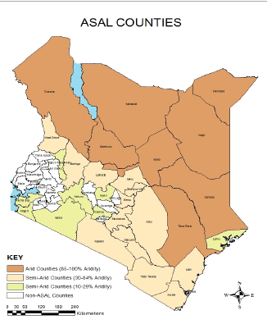
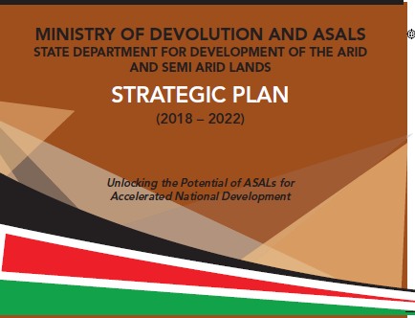

Premise

Slide 3
Background
The State department for development of the ASALs (SddA) was established through executive order no. 1 of June 2018 (revised) following reorganization of government.
The SDDA is a special vehicle for affirmative action, mainstreaming development issues of Arid and Semi-Arid Lands (ASALs), coordinating, implementing and fast-tracking investment in ASALs for long term sustainable development.

Slide 4
Strategic objectives
(i) Coordinate formulation and implementation of policies and strategies for the development of ASALs;
(ii) Build resilience through economic and social intervention programmes;
(iii) Facilitate social cultural integration of communities in ASALs and cross-border areas; and
(iv) Strengthen the institutional leadership of the SDDA

Slide 5
The Global Health Security Agenda
The Role for SDDA
Support work being coordinated by WHO, FAO,OIE to develop an integrated and global package of activities to combat antimicrobial resistance, spanning human, animal, agricultural, food and environmental aspects (i.e. a one-health approach).

Slide 6
Health in the context of development of ASALs
Human Health and well being – Prerequisite for development;
Animal health– Basis of sustainable livelihoods(another prerequisite for development), improved nutrition, reduced zoonotic disease impacting human health;
Agriculture – Food security and nutritional biodiversity;
Environmental Health – Natural resource management and utilization, including locally grown and reared crops and livestock;

Slide 7
State Department – County Co-create
The recent visits to counties by SDDA team and partners to collect county led development priorities generated a case for one health in SDDAs role in partner coordination, with several counties focusing on Human, animal, plant and environmental health

Slide 8
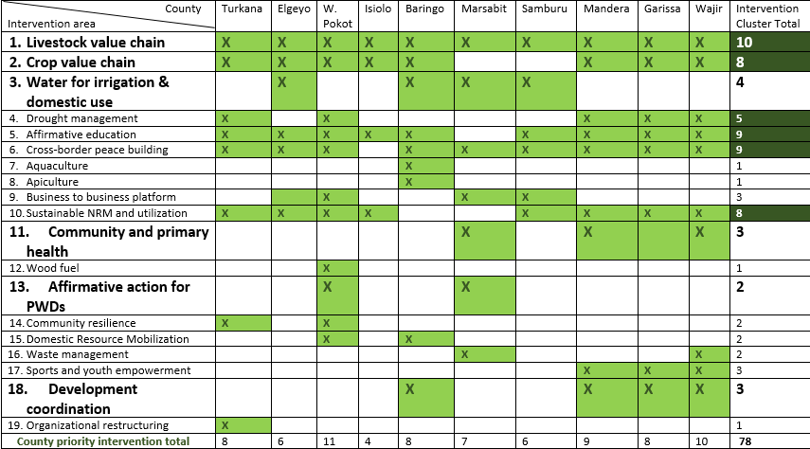
Health and social Determinants of Health in ASALs
Sample prioritisation of a 2019 10 County Co-Create
The Case for one health
.

Slide 9
How ?
All-of-Government and intergovernmental approach;
Partnerships for development;
Coordination of partnerships;
Multi-sectoral interventions;
Domestic resource mobilisation;
Systems strengthening.

Slide 10
Thank you

