Slide 1



INVEST IN AFRICA
Catalyzi ng donor funding
P r e s e n t e d b y P i u s M u c h i r i , C F A A u g 8 , 2 0 1 9
INVESTING WITH PURPOSE

Slide 2
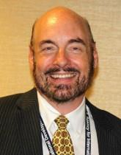
“The US government spends
USD500million per year on
health support in Kenya.”
USAID Mission Director, Mark Meassick
1

Slide 3











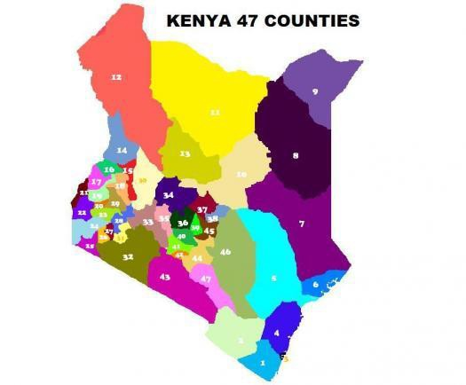


H e a l t h F i n a n c e A c t o r s
Development partners
Implementation Partners
Bungoma teenage mothers organisation
CSOs
2

Slide 4
What challenges are the actors facing?
3

Slide 5
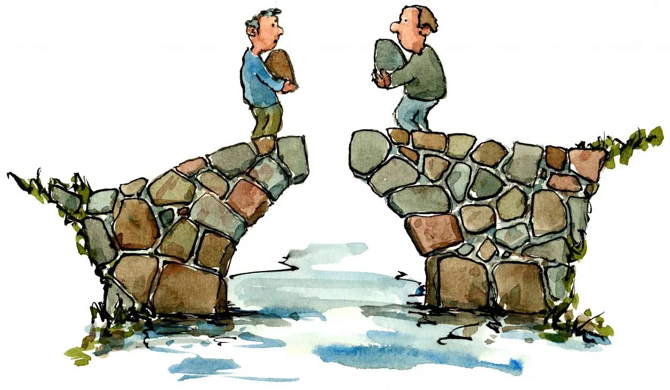
1 . F u n d i n g G a p
4

Slide 6

2 . D o n o r o v e r d e p e n d e n ce
5

Slide 7

3 . F u n d s u n a v a i l a b i l i t y w h e n n e e d e d
6

Slide 8
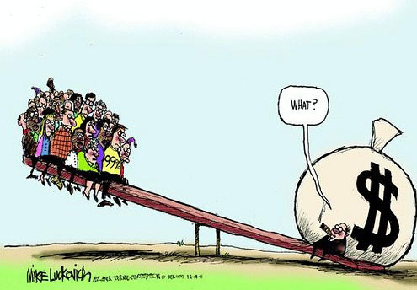
4 . U n d e r u t i l i za t i o n o f f u n ds
7

Slide 9

5 . I d l e f u n d s - e a r n i n g a l m o s t z e r o
8

Slide 10
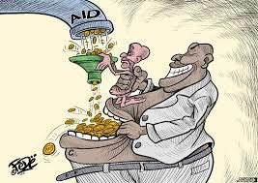
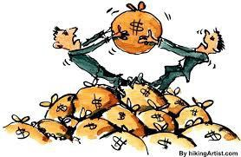
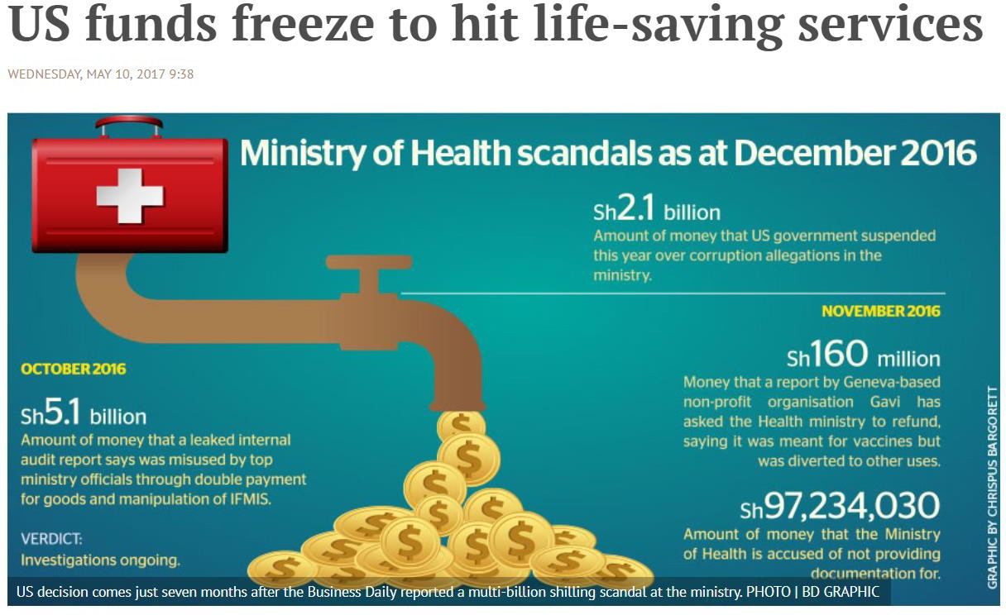
6 . L o o s e g o v e r n a n c e
9

Slide 11
“The health support is a gift from US citizens to Kenyans, but we can tell you having worked in the platform for a year, my country feels fatigued to support the health system.”
USAID Mission Director, Mark Meassick
10

Slide 12
C a n Fund Managers a l l e v i a te s o m e o f t h e c h a l l e n g e s?
INVESTING WITH PURPOSE

Slide 13
W h o i s a f u n d m a n a g e r ?
“A fund manager is an investment professional who conducts research on capital markets securities and manages portfolios
of securities on behalf of clients pursuant to a contract.”
Source CMA Handbook

Slide 14
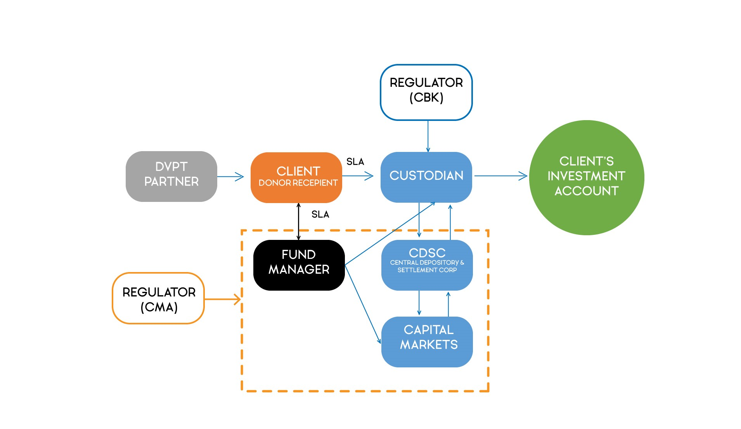
1 . F u n d s ’ S A F E T Y - l a ye r s o f p r o t e c t i on

Slide 15
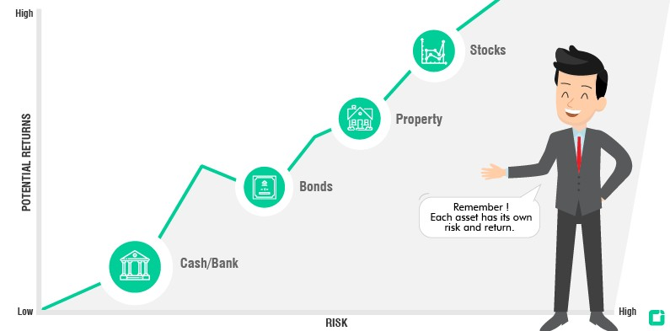
2 . VA L U E - ADD & S U S TA I NAB I LIT Y

Slide 16
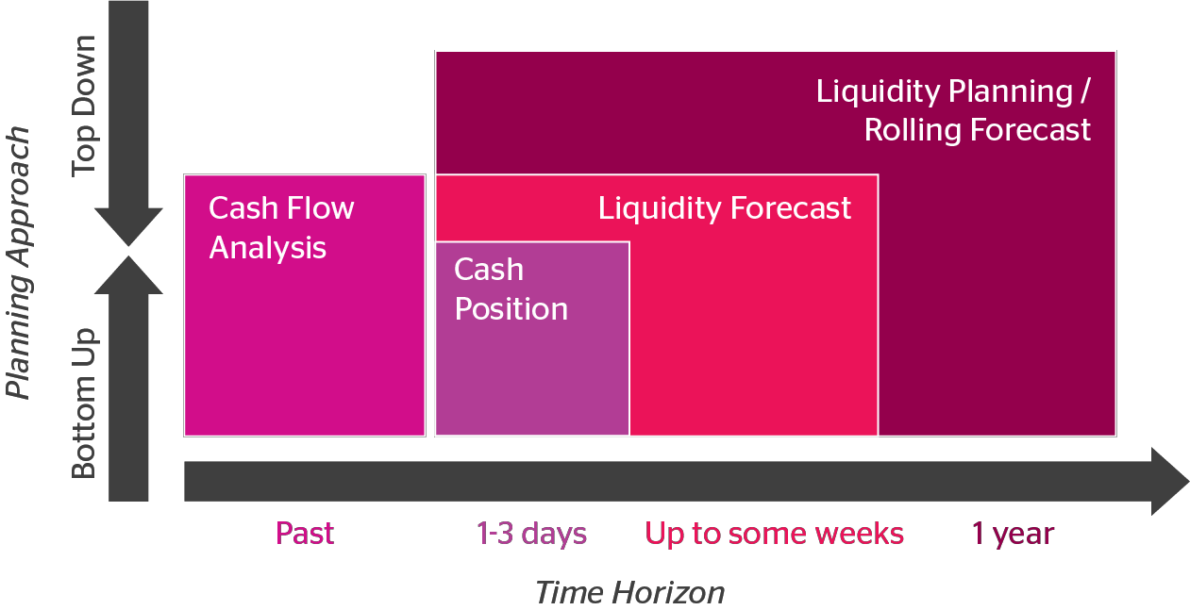
3 . S T R AT E GY & L i q u i d i ty P l a n n i ng

Slide 17
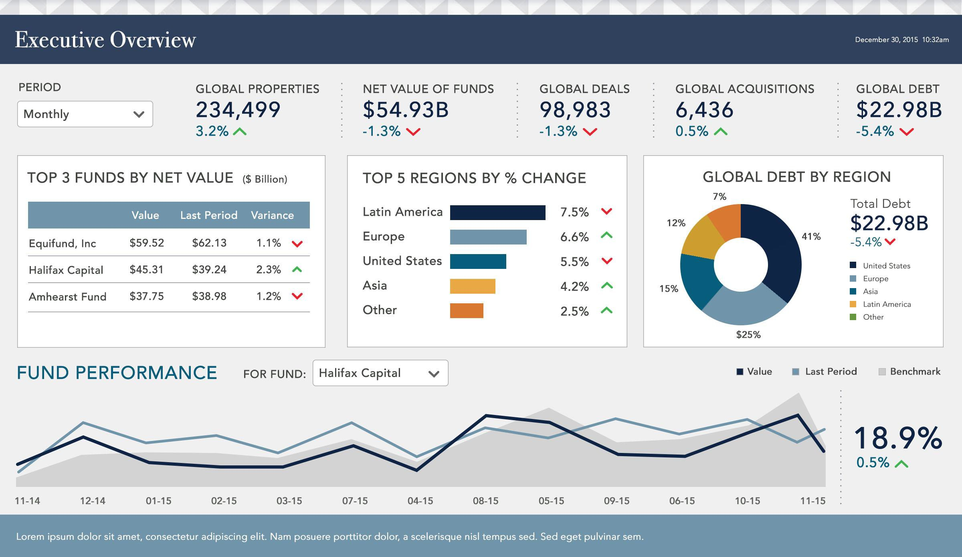
4 . R E P ORT ING – e n h a n c e d t r a n s pa r e n cy & a c c o u n ta b i l i t y

Slide 18
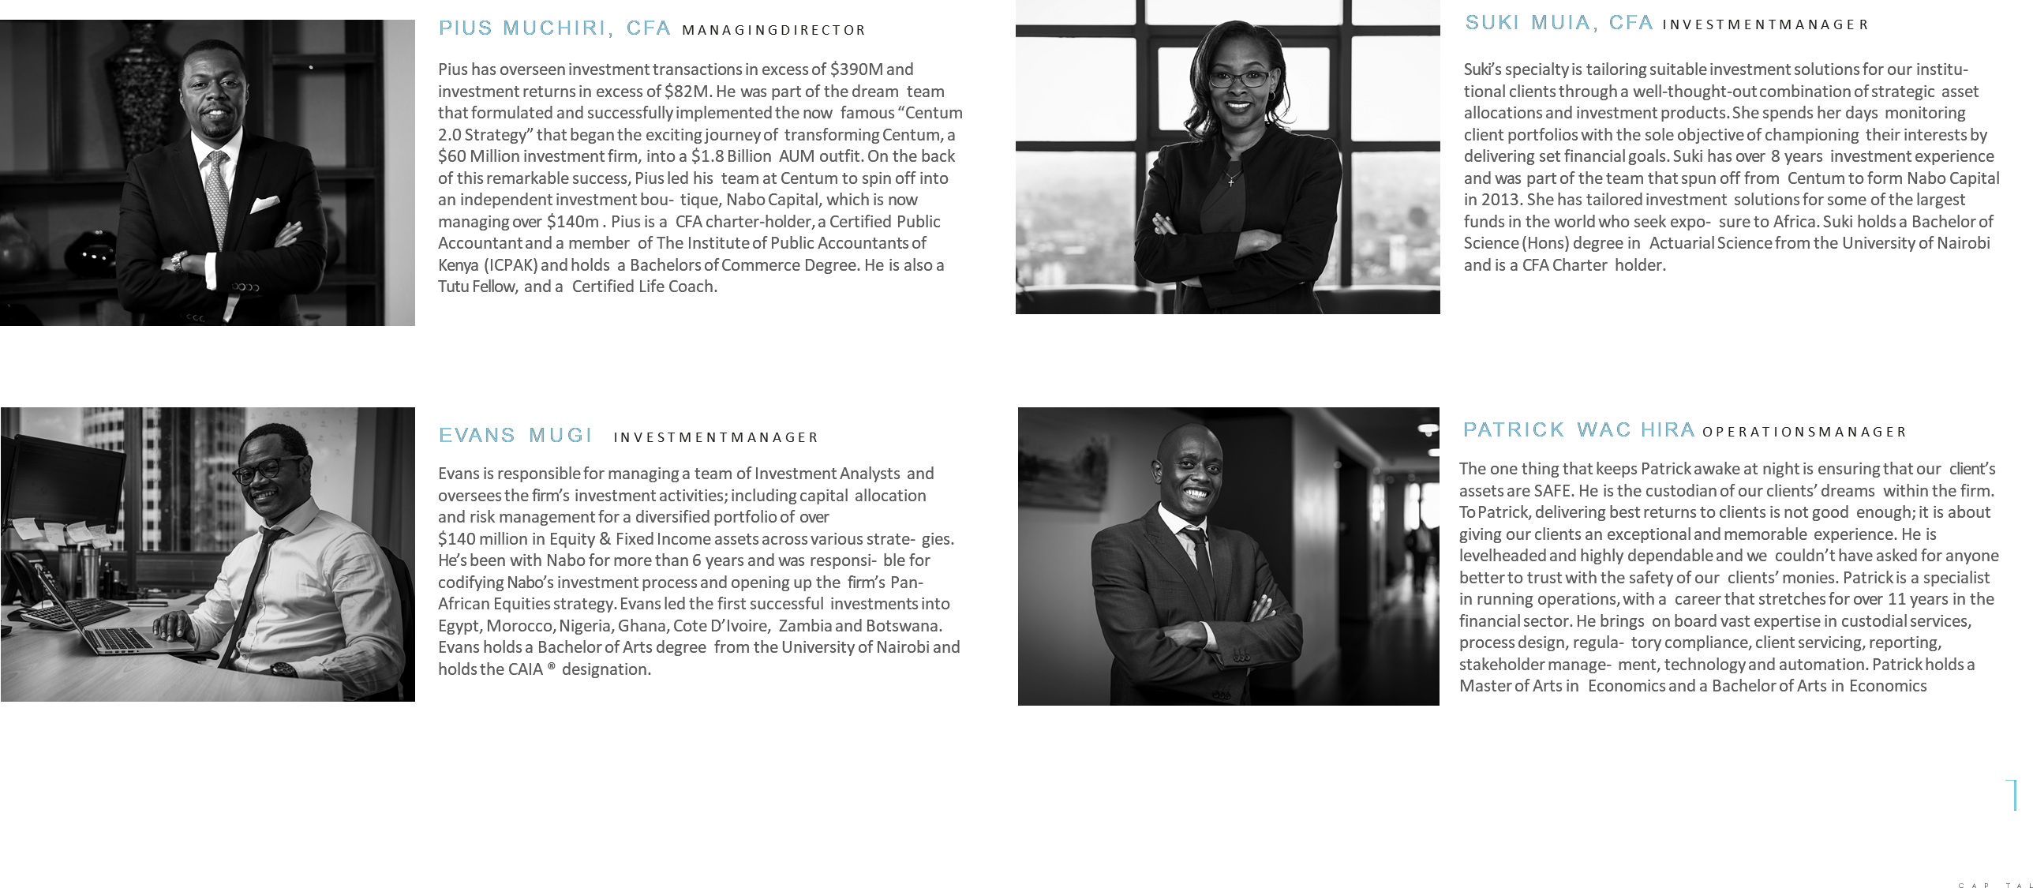
5 . F i n a n c i a l E X P E R T S

Slide 19
6 . R e s o ur c e MOB I L I ZAT ION

Slide 20
I n t r o d uc t i on t o Nabo Capital

Slide 21



RICH HERITAGE
WE ARE A 3RD GENERATION INVESTMENT FIRM WITH OVER 50 YEARS OF EXPERIENCE INVESTING ACROSS SUB- SAHARAN AFRICA
2013
In 2013, the entire QPE team led by Pius Muchiri spun out of Centum and formed Nabo Capital Limited, an independent fully-fledged and licensed Fund Manager. Nabo is a Maasai word meaning Number One, reflective of the company’saspirationto be the leading Fund Manager in Africa.
2008
In 2008,DR. James Mworia was appointed as the CEO of Centum. During the first fiveyears of his tenure, he unbundled the investment portfolio into three distinct businesslines: Real Estate, Private Equityand Quoted Private Equity-QPE(public markets). This focusled to an increase in Centum’sassets from $69 Mn to &610 Mn, and an 8-foldincreasein the share price.
1998
By 1998, Dr. Christopher J. Kirubi had become one of the largest shareholders of Centum & was appointedto the Board. Thereafter, the first independent management team was appointed, beginning a new era of putting together one of the most coveted, youthful and entrepreneurial investment management teams in the region.
1967
Our rich historyof practicing Private Equity in Africabegan. Centum developed a strongreputation as a preferred local partner co-investingalongsideworld renowned multinationalsincluding Coca Cola, General Motors and NAS, among others.
1967
In 1967, ICDC Investment, now Centum Investment, was incorporated as a subsidiary of ICDC. Centum was subsequently listed from day one at the Nairobi Securities Exchangefollowing a successful roadshow that raised USD 26,000 as seed capital.
1954
The rootsof our rich investment heritage can be traced backto the year 1954 when ICDC, a local DFI, was incorporated to
become the investment arm of the Kenyan government in the anticipationthat the Britishcolonial rule was nearing the end.
20
INVESTING WITH PURPOSE

Slide 22

TRACK RECORD – BALANCED STRATEGY
THE QPE BALANCED STRATEGY HAS DELIVERED AN ANNUALIZED ( USD) RETURN OF 15.2% SINCE INCEPTION
GROWTH OF $ 1, 000 INVESTED SINCE MAR 2019
QPE strategy
5,000 4,500 4,000
3,500
3,000
2,500
2,000
1,500
1,000 500
$ 4, 116
MCSI EMF Africaex ZA
$997
Mar-09
Mar-10
Mar-11 Mar-
12
Mar-
13
Mar-
14
Mar-
15
Mar-
16
Mar-17 Mar-
18
Mar-19
Cumulative (USD) Performance (%) | FY2018 | 2 Year Return | 3 Year Return | 5 Year Return | Since Inception
QPE | -6.4% | 28.8.0% | 22.1% | 37.2% | 311.6%
Benchmark (MSCI EF Markets Africa ex.ZA) | 4.7% | 5.1% | -3.1% | -31.5% | -0.3%
*QPE Strategy was launched in March 2009
*The data shown above is as at March 2019
21
INVESTING WITH PURPOSE

Slide 23


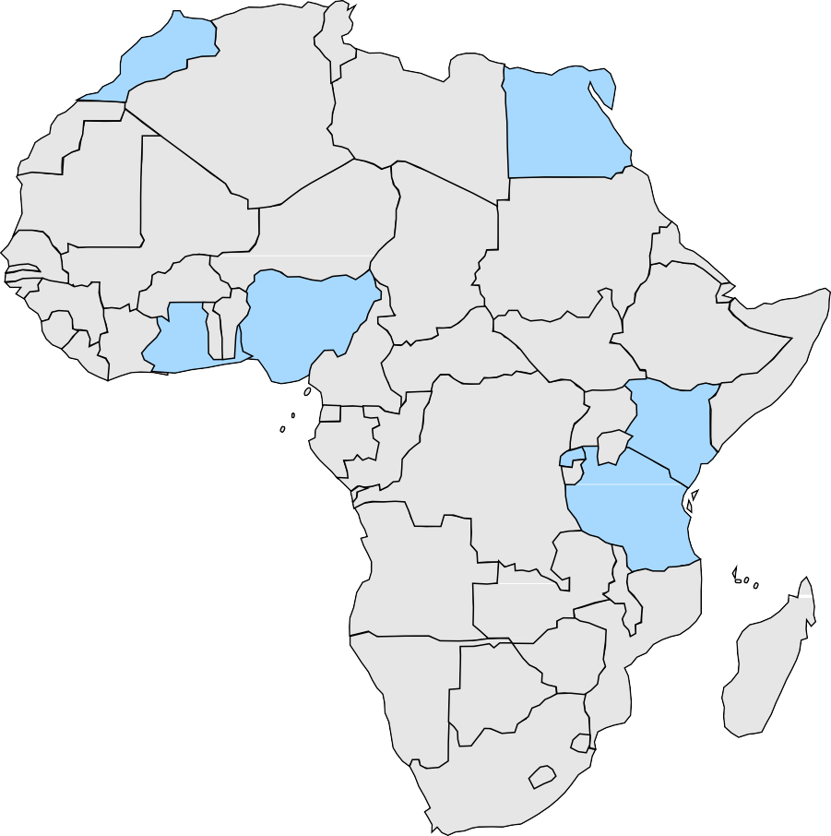



SUCCESSES
OUR INVESTMENT PHYLOSOPHY HAS DELIVERED SUCCESS ACROSS THE CONTINENT
C
ompany: EASTERN TOBACCO
Sector: Consumer Staples
Company: CARBACID Sector: Industrial gases
Total investment: $1.8Mn (Nov ‘14)
Exit multiple: 2.9x
Total investment: $4.1Mn (May 2009)
Exit multiple: 2.9x
EGYPT
Company: CAL BANK GHANA
Sector: Banking
GHANA
Total investment: $4.2Mn (Oct’12)
Exit multiple: 2.1x
KENYA
TANZANIA
Company: TANZANIA BREWERIES
Sector: Consumer Staples
Total investment: $16Mn (Oct 2011)
Exit multiple: 2.7x
Company: BRALIRWA (IPO)
Sector: Consumer Staples
Total investment: $0.4Mn (Nov‘10)
Exit multiple: 5.4x
22
INVESTING WITH PURPOSE

Slide 24












OUR CLIENTS
WE HAVE BEEN ABLE TO ATTRACT BOTH LOCAL AND INTERNATIONAL CLIENTS
INSTITUTIONAL CLIENTS
Sovereign Wealth Funds Endowments
Foundations
Insurance Companies
INDIVIDUAL CLIENTS
Family Offices
High Networth Individuals
23
INVESTING WITH PURPOSE

Slide 25
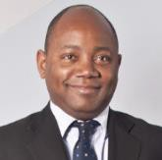
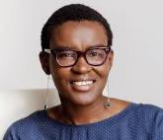
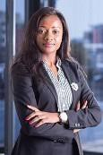
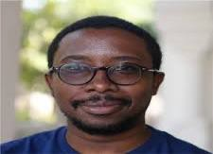
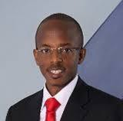
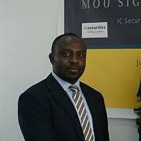
THE BOARD
A PAN-AFRICAN BOARD WITH VAST GLOBAL EXPERIENCE
RO BERT B U N Y I C H A I R M A N & N O N - E X E C U T I V E D I R E C T O R
Robert Bunyi is the Managing Director of the Kenya Pooled Water Fund, KPWF. KPWF is a is a non-profit Kenyan company established to provide water service providers with local long-term capital raised through issuance of bonds listed on the Nairobi Securities
Exchange (NSE). He is also the founder of Mavuno Capital, an investment advisory firm that deals mainly in real estate"
A L L Y A N G U L A
I N D E P E N D E N T N O N E X E C U T I V E D I R E C T O R
Ally Angulla is a Chartered Account and the founder / CEO of Leap Holdings Limited and its subsidiaries, company with interests in farming, manufacturing and retail. She has previously consulted for the Ministry of Finance to reform financial reporting for the government of Namibia. She currently serves on the boards of Bank Of Namibia, Oryx Properties Limited amongst others. Ally is a WEF Young Global Leader award holder, a Dangote Fellow and a Tutu Fellow.
EDW I N M AC HAR IA C H A I R M A N & N O N - E X E C U T I V E D I R E C T O R
Edwin is a Partner and Africa Regional Director for Dalberg Advisors, the global strategy and policy advisory firm focused on shifting the needle on creating an inclusive and sustainable world. He founded Dalberg’s Nairobi office in 2008 and has been a key contributor in building Dalberg’s Africa presence to be the largest top-tier consulting firm on the continent.
T H A P E L O M O R I B A M E I N D E P E N D E N T N O N E X E C U T I V E D I R E C T O R
Thapelo Moribame is the Head of Market Development at the Botswana Stock Exchange, a position held since 2016. She is responsible for the deepening of the financial markets in Botswana, public education on capital markets and corporate communications of the organization. Thapelo has previously held a board position at the Hospitality and Tourism Association of Botswana and has also served as Head of Marketing at Air Botswana and Acting Director – Commercial at the same organi- zation.
FRED M U R I M I
A L T E R N A T I V E D I R E C T O R T O C E N T U M I N V E S T M E N T
D A V I D A W U A H - D A R K O I N D E P E N D E N T N O N E X E C U T I V E D I R E C T O R
David Awuah-Darko is a Co-Founder, Executive Vice Chairman, and Member of Invest- ment Committee at IC Africa Private Equity Limited. He has several years of experience in investment banking, trading, and asset management across several geographic markets including Europe, Asia, Latin America, and Africa. He worked for several years as a European Equities trader at Lehman Brothers"International (Europe) in London,
U.K. At Lehman, he was primarily responsible for Italian equities trading, covering the
MIB30, MIBTEL, Nuovo Mercato, third line, and OTC markets.
Fred Murimi is the Managing Director of Centum Capital, a position he has held since August 2015. He is charged with the responsibility of overseeing the execution of the Centum 3.0 strategy through the development of investment grade opportunities across the eight sectors of focus: Financial Services, FMCG, Power, Real Estate, Agribusiness, Healthcare, Education and ICT. "
"
24
INVESTING WITH PURPOSE

Slide 26
C a l l t o action
Health Finance Actors should consider co-opting Fund Managers like Nabo Capital as finance experts within the existing value chain to help alleviate some of the challenges.
25

Slide 27
“Obstacles are put in your way to test if what you want is really worth fighting for.” anonymous
26

Slide 28


THANK YOU
LOCATED AT INTERNATIONAL HOUSE, MAMA NGINA STREET, 5TH FLOOR. | +254 0709 902 700 | CLIENTSERVICE@NABOCAPITAL.COM | WWW.NABOCAPITAL.COM
S T A T E M E N T O F D I S C L O S U R E A N D C O N F I D E N T I A L I T Y
This document contains proprietary and confidential information. All data submitted to the recipient is provided in reliance upon its consent not to use or disclose any information contained herein except in the context of its business dealings with Nabo Capital.
The recipient of this document agrees to inform present and future user who view or have access to its content of its confidential nature. The recipient agrees to instruct each employee that they must not disclose any information concerning this document to others except to the extent that such matters are generally known to, and are available for use by, the public. The recipient also agrees not to duplicate or distribute or permit others to duplicate or distribute any material contained herein without Nabo Capital express written consent.
By acceptance of this document, the recipient agrees to be bound by the aforementioned statement.

Slide 29
LOCATED AT INTERNATIONAL HOUSE, MAMA NGINA STREET, 5TH FLOOR.
| +254 0709 902 700 | CLIENTSERVICE@ NABOCAPITAL.COM | WWW. NABOCAPITAL. COM
STATEMENT OF DISCLOSURE AND CONFIDENTIALITY
This document contains proprietary and confidential information. All data submitted to the recipient is provided in reliance upon its consent not to use or disclose any information contained herein except in the context of its business dealings with Nabo Capital.
The recipient of this document agrees to inform present and future user who view or have access to its content of its confidential nature.
The recipient agrees to instruct each employee that they must not disclose any information concerning this document to others except
to the extent that such matters are generally known to, and are available for use by, the public. The recipient also agrees not to duplicate or
distribute or permit others to duplicate or distribute any material contained herein without Nabo Capital express written consent.
By acceptance of this document, the recipient agrees to be bound by the aforementioned statement.

