Slide 1

Health Products & Technologies and UHC
Julius OGATO- Head DEPT of NHSS
Presentation at the 3rd Health Sector Development Partner Forum

Slide 2
UHC
Access to safe, effective, quality essential health care services,
Including affordable essential medicines and vaccines for all without going into poverty.

Slide 3
Health systems
All the Institutions, People, and Actions whose primary purpose is to improve Health
Objectives:
Improving people’s health and well being;
Responding to people’s expectations;
Providing protection against the costs of ill-health.

Slide 4
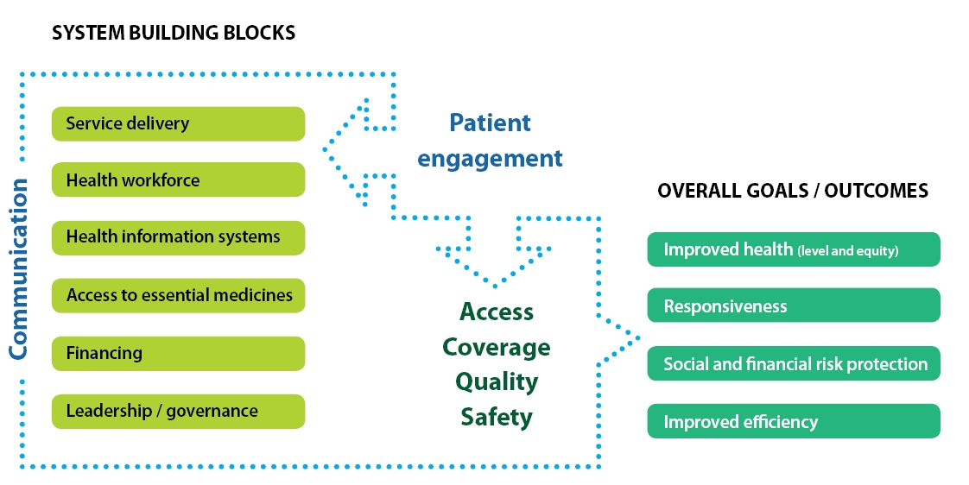
HS BUILDING BLOCKS

Slide 5

Universal Access to Health and
Universal Health Coverage
Absence of geographical, economic, sociocultural, organizational, or gender barriers that prevent all people from making equitable use of comprehensive health services.
Universal Access
Sufficient organizational mechanisms and financing to cover the entire population.
Universal Coverage
Universal coverage in itself is not sufficient to ensure health, well-being, and equity in health.

Slide 6
Goals of Healthcare Delivery System
Quality
Access
Cost
(Often) competing goals

Slide 7

Medical Products, Vaccines and Technologies
Procurement and supply programs need to ensure…
Equitable access
Assured quality
Cost-effective use.
Pro-poor financing of essential products
Local capacity to enforce regulations
Health workers trained in cost-effective prescribing practices

Slide 8
National MTC
Selection, Forecasting, Quantification
Evaluates the:
Clinical use of medicines,
Develops policies for managing medicine use and administration, and
Manages the formulary system

Slide 9
Functions of a MTC
To promote better quality of care and more rational use of medicines through—
  Advising medical, pharmacy, and administrative staff
  Developing pharmaceutical policies and procedures
  Evaluating and selecting formulary medicines
  Identifying medicine use problems
  Promoting interventions to improve medicine use
  Managing ADRs and medication errors

Slide 10
MTC Advisory Functions
Advise medical, administrative, and pharmacy departments
Advise and support other hospital organizations on medicine-related issues
Participate in hospital committees and departments on all matters concerning medicines

Slide 11
HPT Policies and Procedures
Lack of policies will adversely affect HPT selection, procurement, distribution, and use
The MTC has the most expertise to develop policies on—
  New, non-formulary, restricted, investigational medicines
  Pharmaceutical management issues in the hospital
  Monitoring and evaluation of HPT use
  Interventions to promote rational use of HPT

Slide 12
Evaluating and Selecting HPT
Explicit evaluation criteria
  Efficacy, relative efficacy, effectiveness
  Safety, quality, cost
Consistent decision-making
  Evidence-based
  Local context
  Transparency
Evaluation process uses current literature
  Primary sources (especially randomized controlled trials)
  Secondary sources (bulletins and reviews)
  Reliable and current tertiary sources (textbooks)

Slide 13
Identifying Medicine Use Problems (1)
Pharmaceutical procurement and availability
Pharmaceutical distribution
Medicine prescribing
Administration and use
ADR reports
Medication error reports
Antimicrobial resistance surveillance reports

Slide 14
Identifying Medicine Use Problems (2)
Aggregate consumption data—
  From records of procurement records, pharmacy stock, patient records
  ABC, VEN, DDD analysis
  ADR reports
  Medication error reports
  Antimicrobial resistance surveillance reports
Health facility indicators and hospital antimicrobial indicators—indicate general trends in prescribing
Drug use evaluation (DUE)—
  Indicates whether specific diseases are being treated with the correct medicine or whether specific medicines are being given for the correct indications
  Includes continuous monitoring and feedback

Slide 15
Promoting Interventions to Improve Pharmaceutical Use
Educational programs
  Pharmaceutical bulletins and newsletters
  In-service education
Managerial programs
  Standard treatment guidelines (STGs)
  DUE
  Clinical pharmacy programs
  Structured order forms, automatic stop orders
Regulatory programs
  Pharmaceutical registration
  Professional licensing
  Licensing of outlets

Slide 16
Managing ADRs and Medication Errors
The MTC should have a plan to—
  Monitor
  Assess
  Report
  Correct identified problems
  Prevent ADRs

Slide 17
MTC: Structure and Organization (1)
Membership from medical, pharmacy, administration, nursing, public health
Chief doctor is often the chairman
Chief pharmacist is often the secretary
Liaison with Infection Control Committee and Antimicrobial Subcommittee
Regular meetings and regular attendance with minutes
Documented goals, terms of reference, policies, decisions

Slide 18
MTC: Structure and Organization (1)
Membership from medical, pharmacy, administration, nursing, public health
Chief doctor is often the chairman
Chief pharmacist is often the secretary
Liaison with Infection Control Committee and Antimicrobial Subcommittee
Regular meetings and regular attendance with minutes
Documented goals, terms of reference, p

Slide 19
MTC—Structure and Organization (2)
Chairman
Director General of Health
Or other appointed
physician
Physician
Pharmacy
Nursing
Administration
Public Health
Members
Members
Members
Surgeon
Drug
Information
Specialist
Director of
Administrative Officer
Physician
OB/Gyn
Nursing
or other appointee
or Nursing
Pharma-
Representative
Internal Medicine/
cologist
Family Practice
Recording
Infectious Diseases
Secretary

Slide 20
HPT- Lowering the Cost
NMTC
Price Control
Local Manufacturing
Efficient SCM
Capacity Building

Slide 21
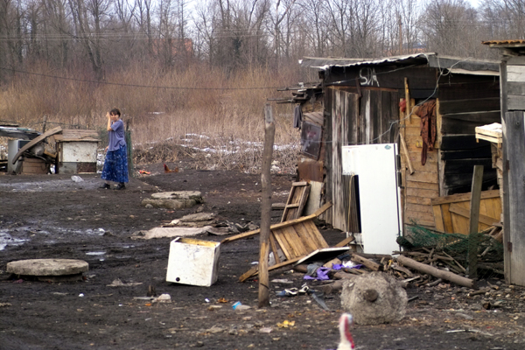
“Because it really does not make much sense to provide excellent care in clinics and hospitals, if people are to return to the conditions that made them ill in the first place”

Slide 22
Talk Health not Disease
Save and Clean Outdoor Environment
Save and Clean Indoor Environment
Adequate Clean Drinking Water
Food Security & Nutrition
Healthful Lifestyle

