Slide 1
Homa Bay
County Health Infrastructure Gaps

Slide 2
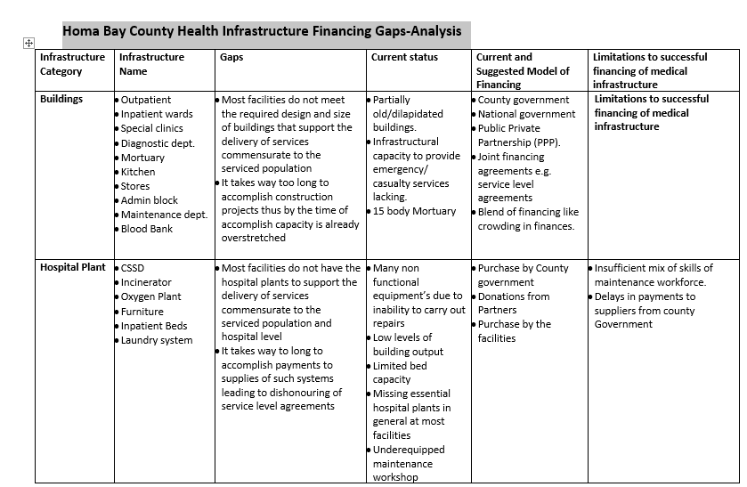

Slide 3
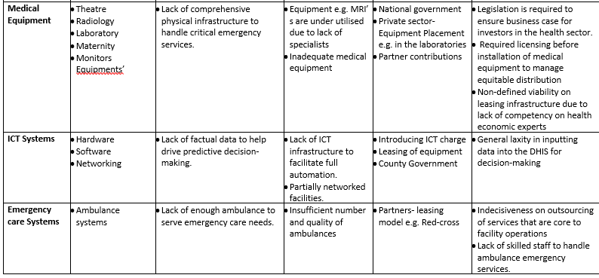

Slide 4
Infrastructure Category
Buildings;
Hospital plant;
Medical equipment;
ICT Systems;
Emergency care systems.

Slide 5
Buildings GAPS
Outpatient
Inpatient wards
Special clinics
Diagnostic dept.
Mortuary
Kitchen
Stores
Admin block
Maintenance dept.
Blood Bank
Most facilities do not meet the required design and size of buildings that support the delivery of services commensurate to the serviced population
It takes way too long to accomplish construction projects thus by the time of accomplish capacity is already overstretched

Slide 6
Current and Suggested Model of Financing
County government
National government
Public Private Partnership (PPP).
Joint financing agreements e.g. service level agreements
Blend of financing like crowding in finances.

Slide 7
Limitations of current financial models
Poor Understanding of the PPP processes by the involved parties.
PPP concept elaborate due to consultations and approvals by national government thus the process not solely in the hands of county governments
PPP must provide value for money

Slide 8
Hospital plant Gaps
CSSD
Incinerator
Oxygen Plant
Furniture
Inpatient Beds
Laundry system
Most facilities do not have the hospital plants to support the delivery of services commensurate to the serviced population and hospital level
It takes way to long to accomplish payments to supplies of such systems leading to dishonouring of service level agreements

Slide 9
Current and Suggested Model of Financing
Limitations to successful financing of medical infrastructure
Insufficient mix of skills of maintenance workforce.
Delays in payments to suppliers from county Government
Purchase by County government
Donations from Partners
Purchase by the facilities

