Slide 1
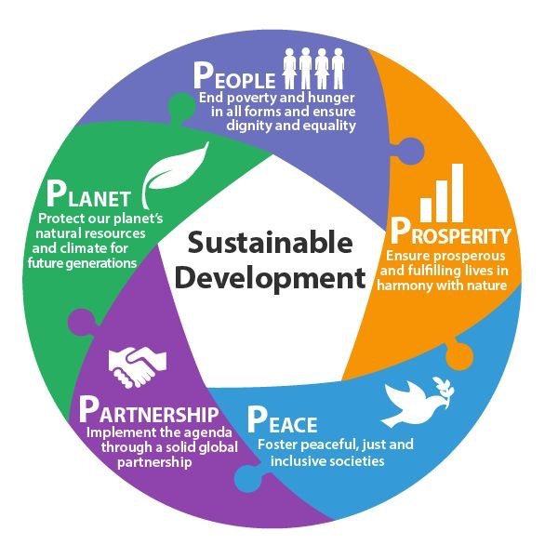
THE THIRD HEALTH SECTOR DEVELOPMENT PARTNER FORUM
Sustainable Domestic Health Financing
MINISTRY OF HEALTH
Presented by:
Njuguna david
Health economist

Slide 2


Slide 3
Introduction
Health care financing remains is a critical element of the social and economic development of a county.
An appropriate health financing mechanism enable achievement of health sector goals ensuring access to quality and affordable health care.
Properly designed health financing systems result to;
  Evidence-based planning,
  Effective human resources planning,
  Proper and effective coordination,
  Political goodwill
  Efficient and effective service delivery

Slide 4
Context
Inequity in health outcomes within and across Member States persist
Still persisting high burden of ill health and death
  Dual burden of communicable and noncommunicable conditions
  A lot of effort needed to sustain gains in communicable conditions
Changing context in countries
  Demographic changes: Youth bulge, ageing populations
  Economic changes: Economic growth, driven by specific sectors (or populations)
  Social / cultural changes: Urbanization, informal settlements,
  Environmental changes: Climate change and effects on development

Slide 5

Health financing and Service delivery: Like Wheels
Financing
Financing and Service delivery is like two wheels.
One without another would not function well.
Wheels without linkage (axle) will not move.
Link
Service Delivery
Notes:
One can consider delivery and finance as two wheels – one without another cannot function and without the axle to link the two, the wheels would not move.

Slide 6
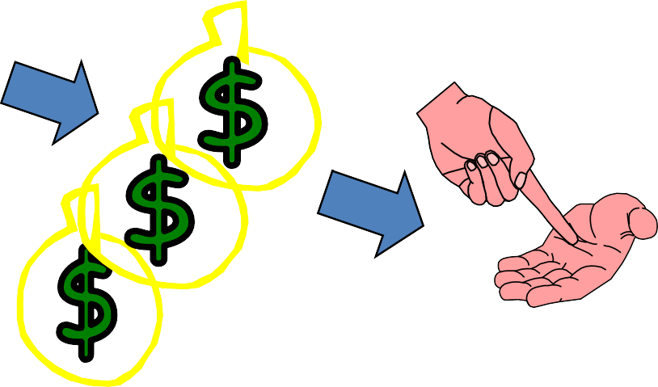
Financing is NOT just about raising more money
Mobilize & Collect Funds
Pool the Risk
Allocate Resources/
Purchase
Payment /definition of entitlements
Notes:
The goals are related to :
Raising sufficient funds and
Providing financial risk protection to the population and
Ensure Efficiency in resource utilization

Slide 7
Selected Health Expenditure Statistics, FY 2001/02 - FY 2015/16
The government expenditure on health as a percent of total government expenditure decreased from 6.1% in FY 2012/13 to 6.7 % in FY 2015/16.
The per capita expenditure, government health expenditure as a percent of THE, and the proportion of GDP spent on health have been increasing since FY 2001/02.

Slide 8
Sustainable Health Financing
Private Sector Corporation
Government
Household funds
Development Partners
Philanthropists

Slide 9
Sources of Health Financing, Kenya
Source: National Health Accounts (Ministry of Health, 2017)
Still the Out of Pocket Payment is high
Concerted efforts by government to increase funds for health
Notes:
Kenya has been faced with the challenge of sustainably raising sufficient resources to finance its health system. Despite government playing an important role in financing health care in Kenya, households still play a pivotal role in healthcare financing
The total out-of-pocket expenditure in KHHEUS 2018 was estimated at KSh 118.2 billion, representing a 36% growth from the estimated 2013 OOP of KSh 85.6 Billion.

Slide 10
Trends in incidence of catastrophic health spending, Kenya 2018
Notes:
Households incurs catastrophic health expenditure if their total household out-of-pocket spending on health exceeds a certain percentage of their total expenditures. The most commonly used thresholds in Kenya are OOP spending on health exceeding 10% of a households’ total expenditure or 40% of their non-food expenditures.

Slide 11
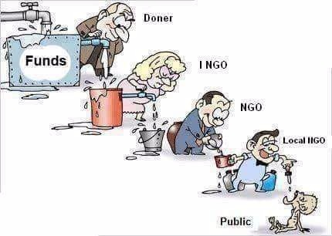
Financing system efficiency?

Slide 12
Per capita out-of-pocket health expenditure by County, Kenya 2018

Slide 13
Combined Health Budget Allocation Pre and Post Devolution
Notes:
Declining donor commitment due to classification of Kenya as a lower middle income country
Porous borders leading to increase in emerging and re-emerging Diseases
Extreme changes in weather conditions caused by the effects of the global climate change has led to increased incidences of diseases.
Re-emergence of neglected tropical diseases e.g. elephantiasis, Kalaazar.
Epidemiologic transition (lifestyle diseases) e.g. cancer, hypertension and other NCDs.

Slide 14
County health Budget Allocation (2013/14 – 2017/18)
Counties increased the proportion of their total budgets allocated to health, from 22 percent in FY 2014/15 to 30 percent in FY 2017/18, indicating the continued county governments’ increasing prioritization of health despite competing needs with other sectors.

Slide 15
Allocations to Health by County FY 2015/16 to 2017/18

Slide 16
Breakdown of Recurrent and Development Allocations, FYs 2013/14 – 2017/18

Slide 17
Trends in Health Insurance Coverage- 2003,2007,2013,2018, Kenya 2018
Notes:
A large proportion (19.5%) of the population in are not covered by health insurance.

Slide 18
Increased access
Gradual increase in access since 2003, trend sharply reversed by 2018. Devolution effects; cost of health care?
Notes:
High cost of health services In Kenya, 28% of the people who reported being sick did not seek care (KHHEUS 2018).
Further 4.9% of households were at risk of impoverishing because of expenditure on health care depleting household savings and were at risk of falling into poverty (KHHEUS 2018).
There was a high increase in self-medication from 30.7 percent in 2013 to 45.2 percent in 2018. High cost of care reduced from 21.4 percent in 2013 to 19.4 percent in 2018.

Slide 20
Financing issues Facing health systems in developing countries
Developing countries donor funding plays a major role in financing health.
Major vertical programs relies heavily on donors finance specifically for treatment and strategic commodities.
Donor support is declining while the government has Not increased funding to bridge the gap
  GDP growing, without commensurate increases in health spending.
The implication of transitioning to a lower middle income country
The widening financing gap as we move to UHC e.g. achieving the Global UN targets e.g. UNAIDS 90-90-90 targets.
The available fiscal space limits expansion of funding to the health sector

Slide 21
Health system strengthening towards sustainable health financing
Reprioritization of public spending towards health - Increasing public expenditure is key to sustainable financing though this has to take into consideration fiscal space and sustainability trade-off.
Development of various pooling mechanism to reduce out of pocket spending by household. No country has ever achieved UHC with voluntary contributions.
ii) Earmarked Funds
Size of revenue pool that can be captured from increased tax administration efficiency is significant and can benefit the health sector. (Earmarked funds introduce rigidity in the budgeting process and the global experience is that earmarks do not achieve desired objectives.
Efficiency Savings
Addressing inefficiencies in health sector service delivery can result in high efficiency gains in health e.g. one health approach/integration approach.

Slide 22
Conclusion
Increase public spending on health to the international recommended targets;
Mobilize more domestic resources to ensure sustainability of provision of health services in view of reduced donor funding.
Expand health insurance (pooling) to reduce the high OOP;
Expansion of insurance - good catalyst for increasing access and reducing OOPs
Explore alternative innovative financing mechanisms such as PPPs);
Ensure efficiency in the utilization of allocated funds.
Align spending to address health outcomes and disease burden.

Slide 23
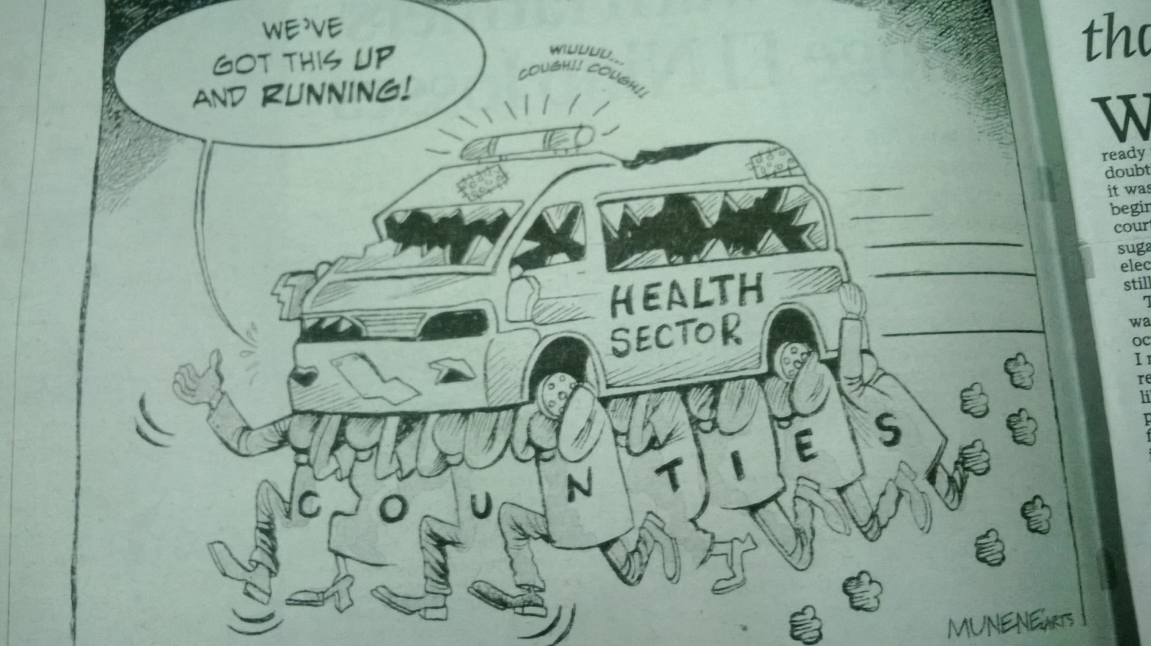
Wrap-up
Cartoon By Munene Arts – Daily Nation 2nd September 2015

Slide 24

THANK YOU

