Slide 1
STRENGTHENING
NATIONAL/SUB-NATIONAL
HEALTH INFORMATION SYSTEM (HIS)
TOWARDS eHealth
THE HEALTH SECTOR DEVELOPMENT PARTNER FORUM
THE CATHOLIC UNIVERSITY OF EAST AFRICA
9th October, 2015
James Kwach Ojwang’
CDC Kenya
HIS Technical Advisor / Member HSS ITT

Slide 2
PRESENTATION OUTLINE
WHAT IS HIS? WHY HIS?
WHAT IS eHealth? WHY eHealth?
INGREDIENTS OF HIS
KENYA HIS LANDSCAPE ACHIEVEMENTS
PLANNED ACTIVITIES
CHALLENGES
COUNTY OPPORTUNITIES
RECOMMENDATIONS

Slide 3
WHAT IS HIS?
Health information systems refer to systems that have the capabilities to capture, store, and process data related to the health of individuals or the activities of organizations that work within the health sector*. The processes can include data management, analysis, transmission, reporting, information e.t.c. geared towards decision making.

Slide 4
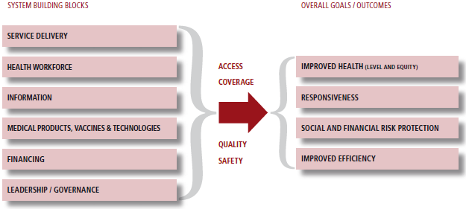
WHY HIS?

Slide 5
WHAT IS eHealth?
eHealth is healthcare practice supported by electronic processes and communication* with a view of enhancing efficiencies in decision making.

Slide 6
WHY eHealth?
Secure, accurate, complete data.
Easy, Faster, and broader shared access.
Privacy.
Accurate and prompt decision making for care.
Faster response.
Efficiencies and possible reduction in costs.
Better quality of care.
Improved health outcomes.

Slide 7
INGREDIENTS OF HIS
HIS
REGULATORY FRAMEWORK
HARDWARE & INFRASTRUCTURE
SOFTWARE
PEOPLEWARE

Slide 8
KENYA HIS LANDSCAPE ACHIEVEMENTS
REGULATORY FRAMEWORK
Laws, Policies, Strategic Plans, Standards and guidelines, and Enterprise Architecture.
SOFTWARE
Data Registries, Repositories, Warehouse, Electronic Medical Records (EMR) Systems, Laboratory Information Management Systems (LIMS), Mobile Health (mHealth), & Human Resources Information System (HRIS).

Slide 9

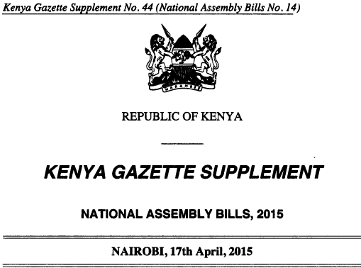

KENYA HIS LANDSCAPE ACHIEVEMENTS
REGULATORY FRAMEWORK - Laws
The Constitution of Kenya 2010
(Article 43, 46, 232)*.
The Health Bill 2015
(Part II Rights and Duties – Health Information and dissemination. Part V - Standards)**.
The Jubilee Manifesto***.

Slide 10

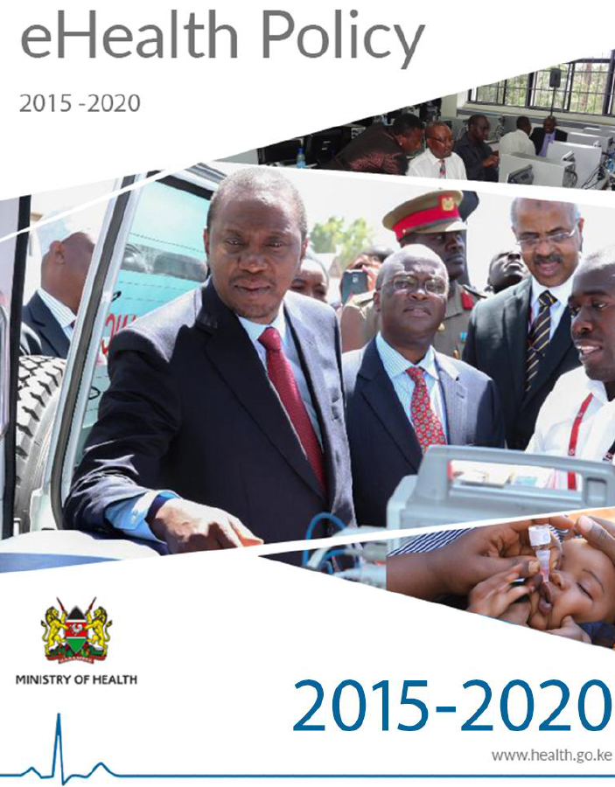
KENYA HIS LANDSCAPE ACHIEVEMENTS
REGULATORY FRAMEWORK - Policies
Kenya Health Policy 2014-2030*.
The eHealth Policy 2015-2020 (Draft).

Slide 11



KENYA HIS LANDSCAPE ACHIEVEMENTS
REGULATORY FRAMEWORK – Strategic Plans
Health Sector Strategic and Investment Plan (KHSSP) 2013-2017*.
Kenya eHealth Strategy 2015-2002 (Draft).
Kenya AIDS Strategic Framework 2014-2019**.

Slide 12



KENYA HIS LANDSCAPE ACHIEVEMENTS
REGULATORY FRAMEWORK – Standards and Guidelines
Primary Health Care Electronic Medical Records Systems*.
Electronic Laboratory Information Systems*.
Electronic Pharmacy Information Systems*.
Standards for Interoperability (Draft).
mHealth Standards (Draft).

Slide 13
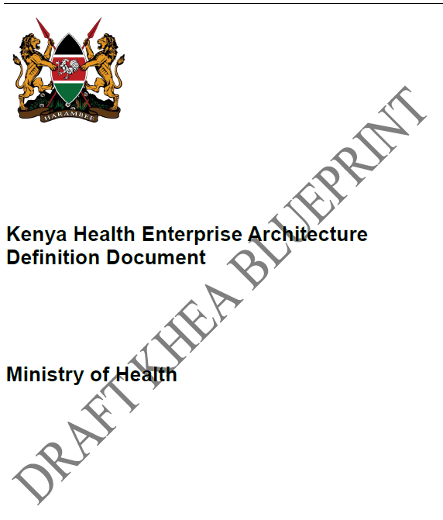
KENYA HIS LANDSCAPE ACHIEVEMENTS
REGULATORY FRAMEWORK – Enterprise Architecture
Kenya Health Enterprise Architecture – Definition Document (Draft).

Slide 14
KENYA HIS LANDSCAPE ACHIEVEMENTS
SOFTWARE - Data Registries, Repositories, Warehouse
Data Registries – Master Facility List (MFL) and Master Persons Index (MPI) through National Unique Persons Identification (NUPI).
Data Repositories – District Health Information System (DHIS II).
Warehouse – NASCOP Health Data Warehouse.

Slide 15
KENYA HIS LANDSCAPE ACHIEVEMENTS
SOFTWARE – Electronic Medical Records (EMR) Systems
Standards-based approach.
27# EMR products assessed.
4 systems closest to standards compliance selected.
Open MRS, IQCare, CPAD, Funsoft.
Open MRS (Kenya EMR), IQCare, and CPAD upgrade to meet the standards.
Kenya EMR and IQCare targeted to be implemented in 600 health facilities.
ITECH (KenyaEMR) & PALLADIUM (IQCare) assigned regions.
643 Health Facilities deployed with standard EMRs.
Currently focusing on optimizing data use.

Slide 16
KENYA HIS LANDSCAPE ACHIEVEMENTS
SOFTWARE – Laboratory Information Management Systems (LIMS)
Standards-based approach.
Reference Laboratories equipped with LABWARE.
20# Health Facilities deployed with Basic LIS (BLIS).
1 Health Facility deployed with Open ELIS.

Slide 17
SOFTWARE – Pharmacy Info Systems
KENYA HIS LANDSCAPE ACHIEVEMENTS
Antiretroviral Dispensing Tool (ADT) developed by USAID/MSH.
An easy-to-use electronic pharmacy management software.
Tracks patient information and monitors the ARVs being prescribed and dispensed.
The ADT tool is being rolled out in all health facilities offering ART throughout Kenya.

Slide 18
KENYA HIS LANDSCAPE ACHIEVEMENTS
SOFTWARE – Mobile Health (mHealth)
eMobile – Health Commodities – KEMSA.
Text for Life (T4L) – Blood donor management.
mPEP – Health care worker PEP adherence.
ART for Live (A4L) – ART adherence.
SMS Printers – Lab results transmission (EID, CD4, Viral Load, TB).
eLearning – Mobile Learning.
Other alert/reminder systems to increase access.
Done through PPP grant under CDC foundation and mHealth Kenya

Slide 19
KENYA HIS LANDSCAPE ACHIEVEMENTS
SOFTWARE – Human Resource Information System (HRIS)
rHRIS – Single platform system supporting eigh regulatory bodies (NCK, MPDB, KMLTTB, COC, PPB, PHOTC, RPB, SORK)
iHRIS – Open source HRIS system used by MOH and now deployed in 20 counties for managing the health workforce in deployment including training monitoring.

Slide 20
CHALLENGES
Uninformed implementation methodologies.
Low adoption rates.
HIS Coordination.
Duplication of efforts and parallel systems.
Proliferation of systems.
Slow stakeholder buy in.
Inadequate availability of technical support.
Scanty evidence base for success.
Low utility rates.
Lack of interoperability solutions.
Change management.
Policy Framework.
Lack of policies for unique identification of patients.

Slide 21
COUNTY OPPORTUNITIES
Adaptation of existing strategy and policy documents.
Scale-up of tested EHR systems which have been shown to work in HIV care.
Implement interoperable solution (don’t re-invent the wheel).
Available technical capacity for advice.
Application of mHealth solutions where appropriate due to wide cell-phone coverage.
Possibility of public-private-partnerships in eHealth projects.

Slide 22
RECOMMENDATIONS
Create HIS coordination structures and promote integrates solutions.
Increase eHealth adoption including academia.
Create data demand to create data use and quality to improve evidence based decision making.
Sensitization on appropriate approaches towards the implementation of HIS projects.

Slide 23
THANK YOU

