Slide 1


Africa Capacity Alliance
Changing lives through better health
Facilitating Development of PPPs in Health
___________
The Journey So Far
Presented by: Elizabeth Mwashuma,
Technical Officer, Public Private Partnerships

Slide 2
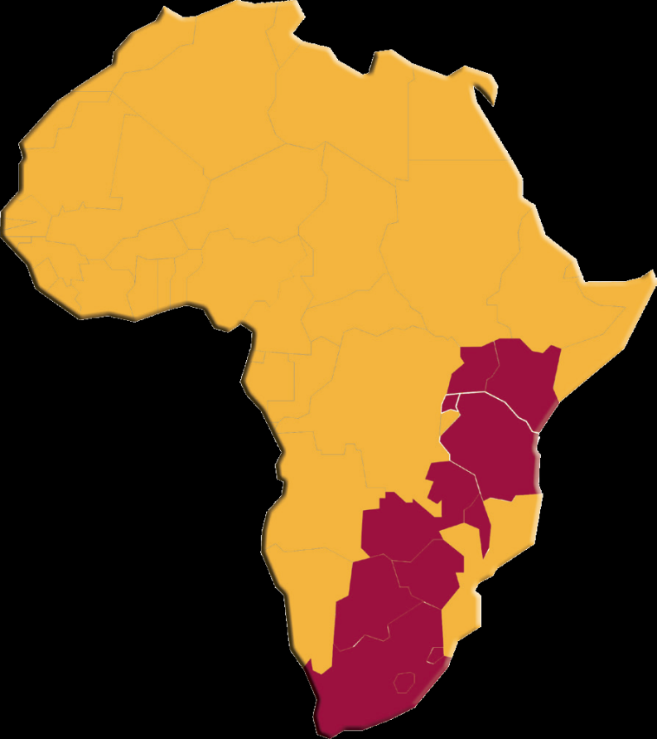
Africa Capacity Alliance
  Alliance of member institutions
  Currently 37 in 12 countries
  Key pillars: HSS, CSS, PPP
  One of the key strategic objective is to foster PPPs in health.
    Through Technical support
    Capacity and skills enhancement
    Facilitating a platform of engagement and partnering process

Slide 3
History & Achievements
Formerly known as RATN was founded in 1997 as a joint project of the University of Nairobi & University of Manitoba, with support from the CIDA, now Department of Foreign Affairs, Trade & Development (DFATD).
The project formed a network of training institutions to address the lack of HIV and AIDS-specific training for healthcare workers in resource-limited settings.
The network originally included 17 Member Institutions (MIs) in 7 countries.
RATN evolved into an independent NGO with a focus on capacity building for health.

Slide 4
History & Achievements (2)
The network currently has 37 MIs in 12 countries in SSA
Over the last 16, ACA has delivered 570 courses & trained close to 8,000 healthcare workers who have impacted millions of patients.
While training remains a core component of its work, ACA has expanded its activities to include technical & institutional capacity building, advocacy, research, knowledge & information sharing.
ACA has built the capacity of its 37 Mis (Technical & Institutional)
ACA built capacities of other organisation through projects (RECABASO, RAIG, INSTANT, Fanikisha)

Slide 5
History & Achievements (3)
ACA’s technical expertise has also expanded beyond HIV and AIDS
To reflect this larger mandate & its expanded geographical scope, RATN changed its name to ACA in January 2014. ACA launched its next five-year Strategic Plan (2014-2019) in March 2014
The SP charts a path for the organisation to implement its recalibrated mission of providing sustainable capacity solutions that will improve health outcomes, & therefore lives, in Africa.

Slide 6
ACA Strategic Pillars
A
Healthy Lives, Better Africa, Better World
Improved Health Outcomes in Africa
B
C
HEALTH SYSTEMS STRENGTHENING (HSS)
COMMUNITY SYSTEMS STRENGTHENING (CSS)
STRENGTHENING PUBLIC-PRIVATE PARTNERSHIPS (PPPs)
Technical capacity(Human Capacity Skills and Knowledge)
Institutional capacity(Organizational Systems)
Adaptive capacity(Develop Learning Institutions)
Influencing capacity(Organizations as Change Agents for Health Sector)
D
Technical Support and Quality Assurance
E
Resource Mobilization and Grants Management
A– The ACA Vision B– The expected impact of ACA activities C– ACA’s Strategic programming pillars D– ACA’s capacity building components E– Cross-Cutting Functions for the Alliance
Knowledge and Lessons Sharing
Advocacy and Partnerships
Evidence and Accountability of Results
Key elements of the ACA Intervention Framework:

Slide 7
Institutional Strengthening Process
Awareness creation & applications
Screening for deficiencies
Alignment/
tailoring of solutions
Development/
supporting of learning communities

Slide 8
ACA’s Projects and Activities
This include:
Centre for Health Market Innovations (CHMI)- Coordinated by Results for Development, CHMI promotes programs, policies and practices that make quality health care delivered by private organizations affordable and accessible.
Network for Africa- Network for Africa is an online community that strengthens the capacity of African public and private health sector leaders to partner for greater public health outcomes.
Business skills training- Small & medium sized healthcare enterprises
Notes:
CHMI Approaches
Organizing delivery
Cooperatives
Social franchising
Health service chains\ networks
Professional associations
Financing care
Government health insurance
Health savings
Micro/ community health insurance
Vouchers
Cross-subsidization
Contracting
Regulating performances
Expansion incentives
Licensing and accreditation
Monitoring standards
Pay for performance
Policy/ legislation
Changing behaviors
Conditional cash transfer
Consumer association
Consumer education
Provider training
Social marketing
Enhancing processes
ICT
Innovative operational processes
Laboratory testing and diagnostics
Mobile clinics
Products/ equipment
Supply chain enhancements
Health focus
MNCH
HIV/ AIDS
FP & RH
Pharmacy services
TB
Malaria and other vector borne diseases
Mental health
Emergency care
Nutrition
Eye care
Dentistry
Rehabilitation care
NCDs
Communicable diseases
Primary care
Secondary/ tertiary care
Funding sources
Donor
Government
In kind contributions
Investor capital
Revenue
Self-funded (bootstrapped)

Slide 9
Healthcare Strengthening through Capacity Building
USAID Capacity Building for Regional and Local NGOs in East Africa
CB for Inadequately Served Population
Network for Africa
Health Market Innovations
Business Skills Training (BST) Course

Slide 10
Network for Africa
Platform providing opportunity for increased collaboration in health sector
Brings together public and private sector actors
It’s a first stop shop for all information on public private partnerships in health
  Publication and resources
  Events and Technical meetings
  Webinars
  www.africacapacityalliance.org/n4a

Slide 11
Health Market Innovations
Global initiative
Mandate: identify, analyze, connect innovative health programs and facilitate their scale up through linkages
ACA’s mandate: identify and connect health innovations with funders, investors, national and county governments for better health outcomes
  Yr1 – Health Innovations Award
  Yr 2 - Round Table Discussions on strengthening MNCH outcomes

Slide 12
CHMI/ ACA RTDs
Series of 4 RTDs
Theme: Strengthening the healthcare ecosystem thorugh
  Fact finding mission – RTD1
    Understanding challenges and gaps at the county

Slide 13
Roundtable Discussions
Goal & Expected Outcomes
Goal: To contribute to the strengthening of the health market ecosystem in MNCH through innovations
How: Create opportunities for partnerships between stakeholders (private health innovators, investors, government incl. county level and development partners) by facilitating a platform of engagement and partnering process
Outcomes: -Formation of PPPs and scale up of innovations
-Identification & dialogue on policy-level directions for strengthening the health market ecosystem
-Enhanced capacities for effective PPP in health programs

Slide 14
Purpose of Roundtable Discussions
To meet other innovators
  For encouragement - "I am not alone.“ “Here I am understood”.
  Confidence - "I'm not so crazy after all."
  Relationship - Develop on-going friendships
To advance diffusion of innovation
  Sharing knowledge, lessons learned & experiences.
  Sorting out the big pic. How does it all fit? Where are we going?
  Synergy of new ideas, new perspectives & new dreams
To facilitate collaboration
  Explore opportunities for teaming up to accomplish common goals
  Develop synergies between the innovators and the investors
  "Network" - Learn who knows what and who is doing what
Facilitate partnership between innovators and counties

Slide 15
Roundtable Discussions Approach
An open process where all actors come together to find solution to a particular challenge
The Roundtables process includes:
  Technical exchanges
  Policy dialogues
  Showcase of innovative work in MNCH
  Networking

Slide 16
Key milestones to Date
Four Roundtable Discussions held
  November 2014
  February 2015
  April 2015
  July 2015
  Facilitated discussions on successes, challenges & practical solutions towards promotion of health innovations at the county level
Facilitated formation of partnerships between innovators & county governments
Policy suggestions for strengthening health market ecosystem
Facilitated identification and formation of partnerships

Slide 17
Key Results
Formation of partnership
    Meru County
  Following meetings and discussions with IFC – World Bank representatives at the CHMI Roundtable meetings, the World Bank is currently supporting Meru County to strengthen the quality of care in the county.
  Linkage between Meru County with both Phillips Healthcare and MobileODT created from one of the CHMI Roundtables and partnership established with a focus on improving cancer care.
  Policy to strengthen health market ecosystem- Supported the development of Malawi PPP guidelines for HIV&AIDS
  Linking of innovators and investors- Linked the Makers movement MNCH with Intellecap

Slide 18
Many Questions Still Remain
What kind of financing model is most likely to unlock additional private sector participation in Health?
How to reconcile diverse requirements and needs
  Varying Country and County contexts
How could those convening MNCH PPPs better structure their support?
  Innovators are challenged in mobilizing adequate start-up Capital
  Investors (donor/private sector) demand for value/scale

Slide 19
For additional information on ACA and CHMI, please visit www.africacapacityalliance.org
www.africacapacityalliance.org/n4a
www.healthmarketinnovations.org

Slide 20

Thank You!

